Slide 1


Server-Driven Video Streaming for Deep Learning Inference
Kuntai Du, Ahsan Pervaiz, Xin Yuan, Aakanksha Chowdhery, Qizheng Zhang, Henry Hoffman, Junchen Jiang
Notes:
Hello, everyone. Today I am going to present the paper "Server-Driven Video Streaming for Deep Learning Inference". I am Kuntai Du, a first-year Ph.D. student from University of Chicago. This is a joint work of me, Ahsan Pervaiz, Xin Yuan, Aakanksha Chowdhery fromm Google, Qizheng Zhang, Henry Hoffman and Junchen Jiang.

Slide 2
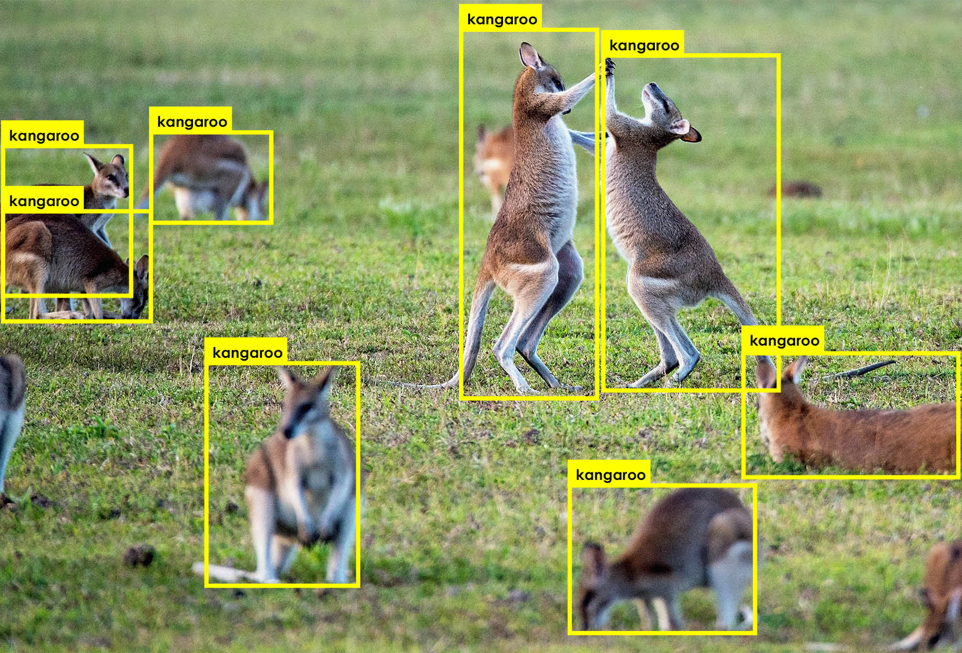
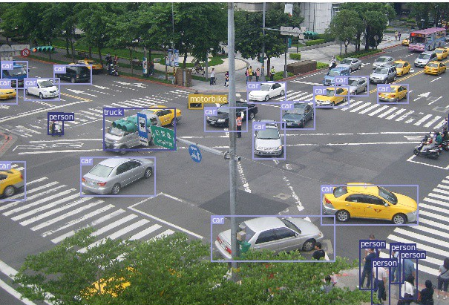
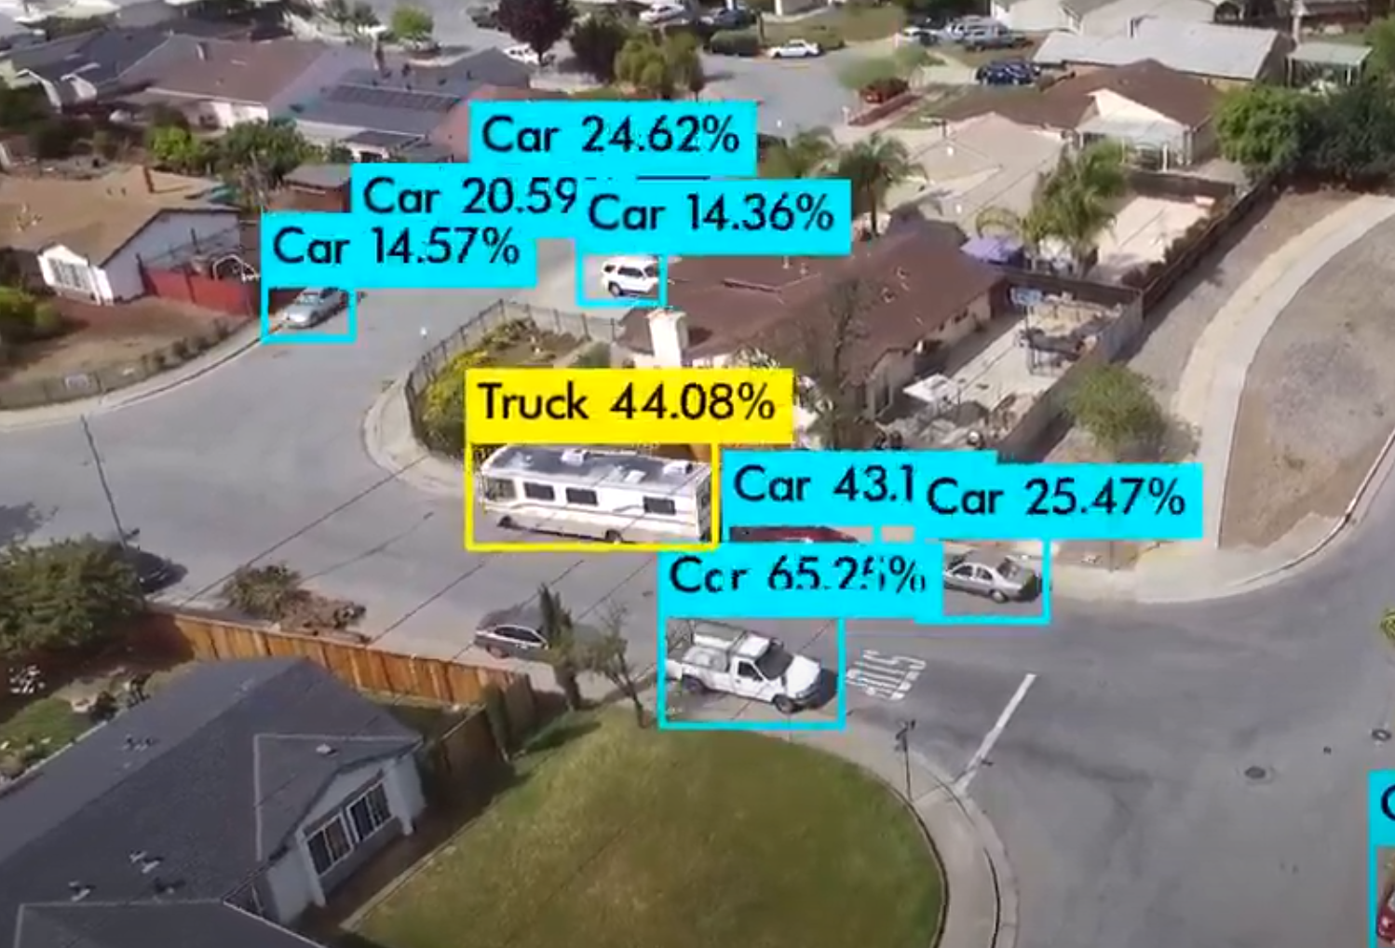
Video streaming for analytics is pervasive
Wild-life camera
Traffic camera
Drone camera
Our goal: scale out video streaming for analytics.
Notes:
Nowadays, DNN-based video analytics becomes more and more pervasive. For example, people deploy wild-life camera and run analytics to learn about the habits of wild animals.
On the street, people deploy traffic camera and run analytics to monitor the current traffic condition and generate valuable insight.
Last but not least, people also use drone and run analytics for multiple purposes.

Slide 3
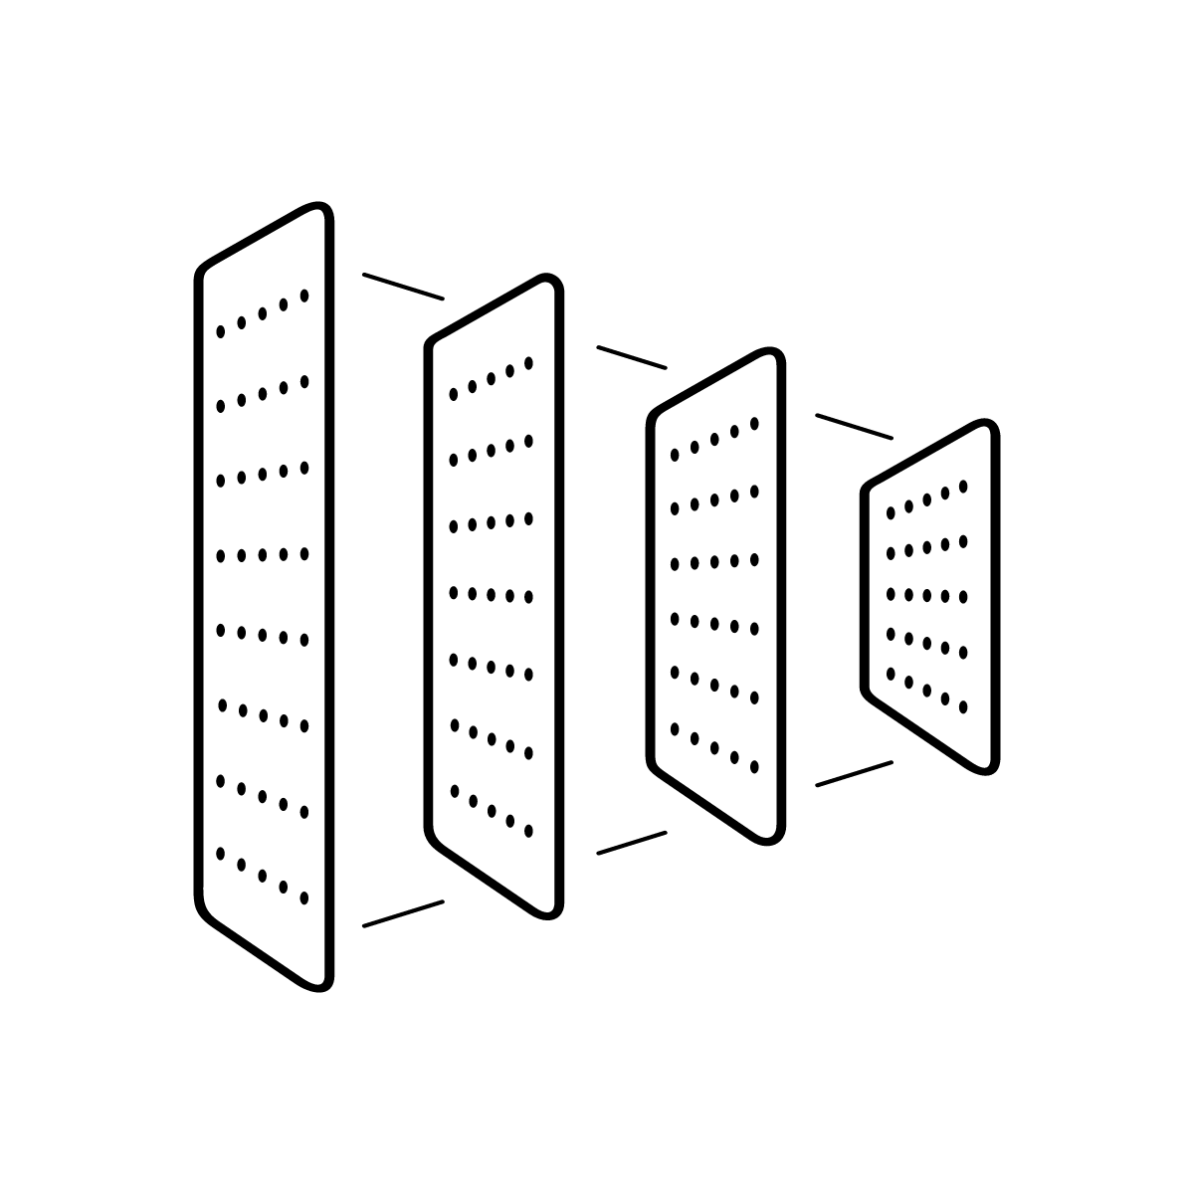




Design goals of video streaming protocol
Network
Camera
Server-side DNN
Preserver high accuracy
Save bandwidth
Bandwidth cost$↓$
Response delay $↓$

Slide 4

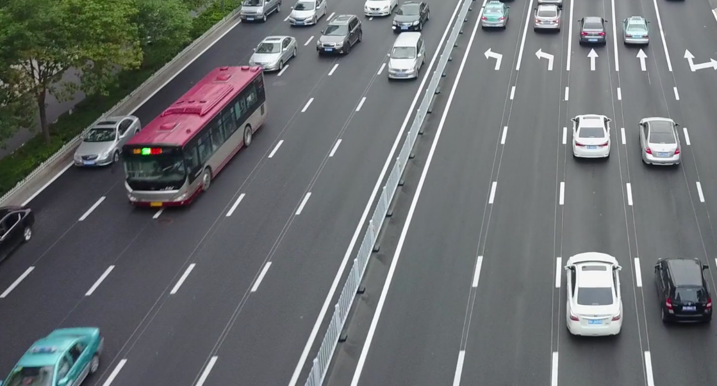
Bandwidth saving opportunity
Video server
Human viewer
Camera
Server-side DNN
Video analytics enable aggressive compression on non-object pixels.

Slide 5
Previous work: real-time camera-side heuristics
Missed objects
Camera
Server-side DNN
Missed objects
Real-time camera-side heuristics
Real-time camera-side heuristics
Ideal
Camera-side compute is too limited to support accurate heuristics.

Slide 6
Challenge
Server-side-DNN-driven + in real time.
Surprisingly difficult: A chicken-egg problem:
Encode current video by the feedback of current video
See the video first and iterate on how to encode the video

Slide 7
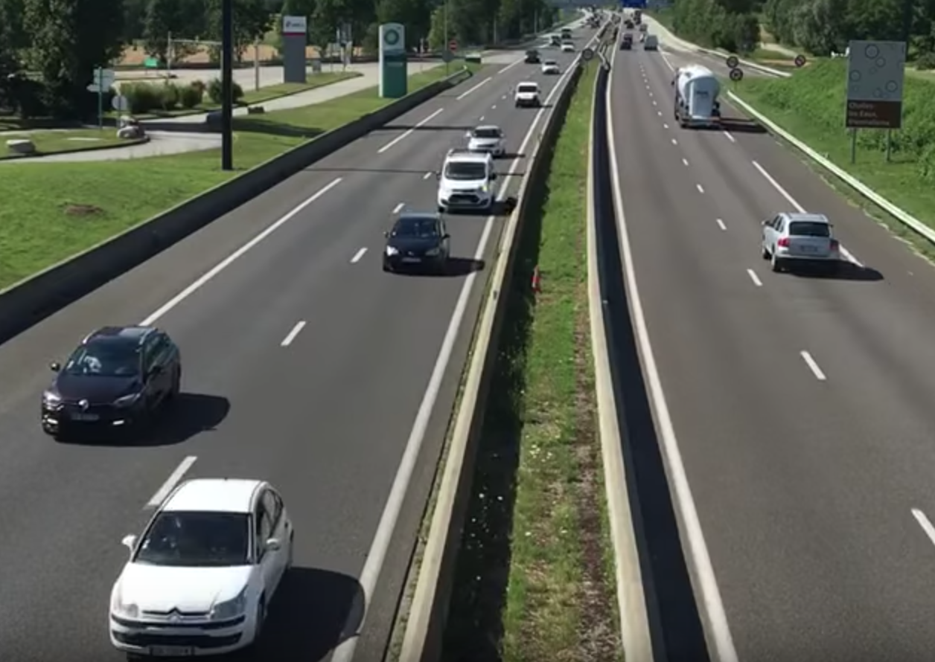
DNN-Driven Streaming (DDS)
Raw video segment
Camera
Server
Server-side DNN
Feedback regions
Inference results
Feedback regions
Feedback regions
Iteration: server-side-DNN feedback regions, higher quality

Slide 8
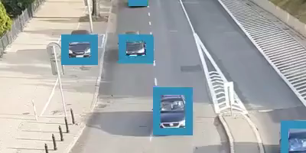
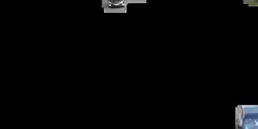

Demo
Objects before iteration
Objects after iteration
Before iteration
Video sent
for iteration
After iteration
DDS encodes and recalls undetected objects through the iteration.

Slide 9
Example: object detection
Regions that may
have objects
Eliminate
confidently-detected regions
Re-encode
in higher quality
Generate with little overhead
DNN is already confident
DDS finds the regions that are almost detected but not.

Slide 10
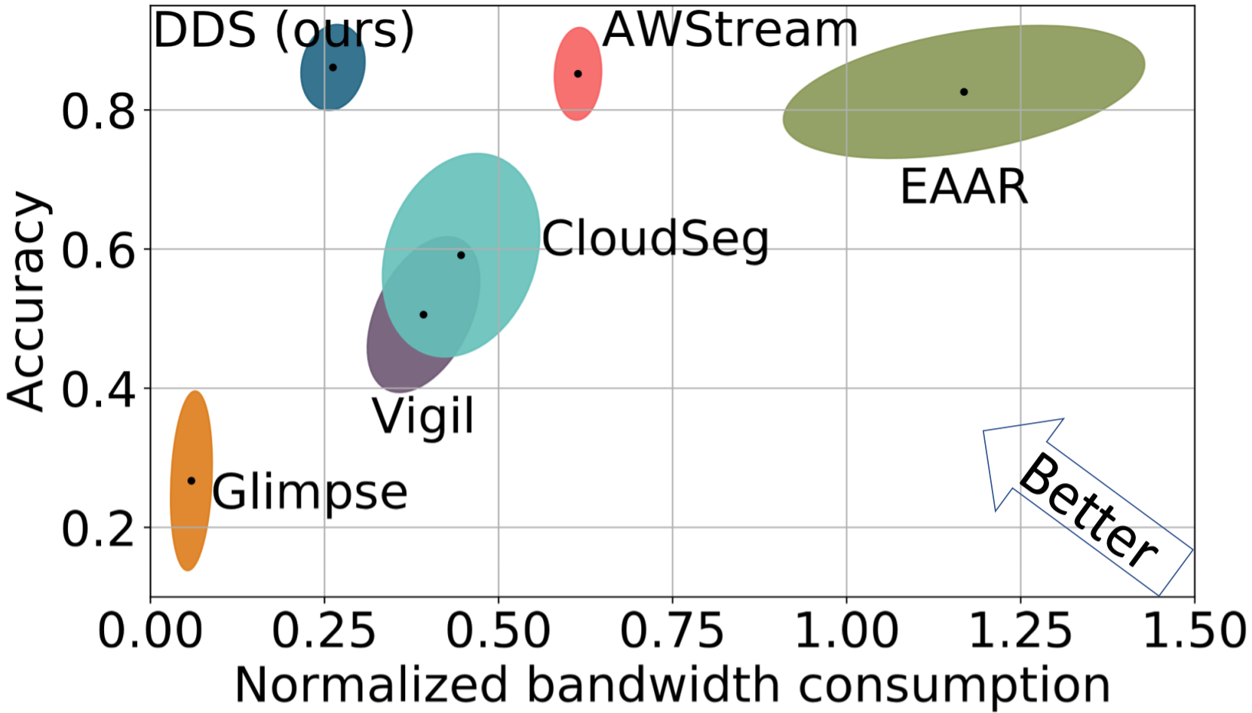
Accuracy-bandwidth trade-off
Better
DDS can save upto 59% bandwidth and achieve higher accuracy.

Slide 11
Conclusion
Our contribution:
bandwidth-accuracy trade-off ➔
real-time server-driven ➔
DDS: iterative workflow
Results: better bandwidth-accuracy trade-off
More resources (and lessons from DDS): https://kuntaidu.github.io/aboutme
The next talk: Reducto: compute-accuracy trade-off ➔ real-time camera-driven.

